Slide 1
RC1
VC 210 Recitation Class
Linda Wei
SJTU

Slide 2
Comments
Something I want to say about the class:
1、 Everyone can learn this course well as long as he spares no effort, including those who didn’t take chemistry course in high school! Since this course doesn’t contain something about Elemental chemistry and organic chemistry.
2、Please remember to take note to make your cheating paper, but don’t merely rely on your cheating paper.You should completely understand the formula on slides!
3、 Make sure you understand everything in your homework and do exercise on the textbook is also a good choice.

Slide 3
1.Foundamental

Slide 4
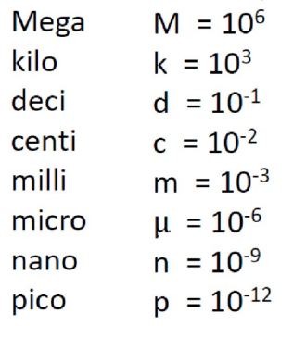
Unit
SI unit: K, s, kg

Slide 5
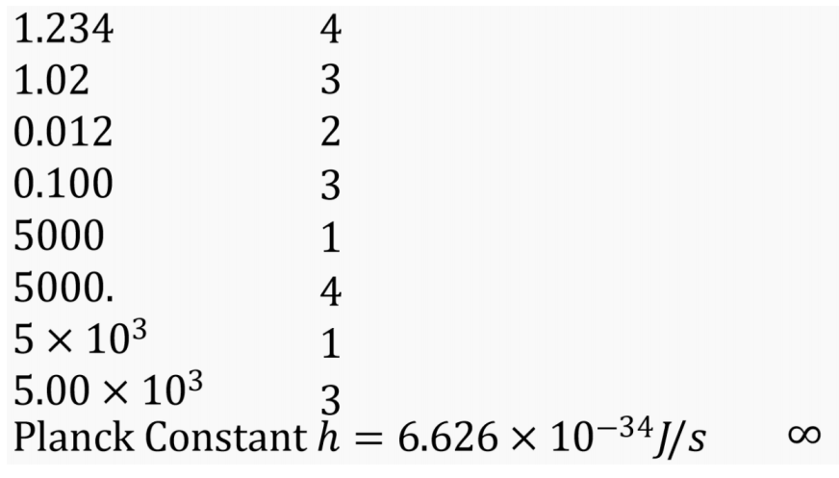
Significant Numbers

Slide 6
Significant Numbers
Addition and Subtraction
When adding or subtracting, make sure that the number of decimal places in the result, is the same as the smallest number of decimal places in the data. For example, 0.10 g + 0.024 g = 0.12 g.
Multiplication and Division
Similar to addition and subtraction For example, (8.62 g)/(2.0 cm) = 4.3g/cm.
Logarithms and Exponentials
Logarithms: the mantissa of a common logarithm has the same number of significant figures as the original number.
Exponentials: the exponential of a number has the same number of SF as the mantissa.
log 2.45 = 0.389, 10^(0.389) = 2.45, 10^(12.389) = 2.45

Slide 7
Round off
Up if last digit is larger than 5, down if last digit is smaller than 5
For number sending in 5, always round to the nearest even number (4 or 6).

Slide 8
Matter
element
atoms: count protons, neutrons, atomic number
molecule & ion (cation[+] & anion[-])
Requirements: able to recognize the name.
compound & mixture (heterogeneous or homogeneous).
state of matter: gas (g), liquid (l), solid (s).

Slide 9
Chemical Formula
Empirical formulas: only show ratio of atoms
Molecular formulas: actual number of atoms

Slide 10
2、Quantum

Slide 11

Electronmagnetic wave

Slide 12
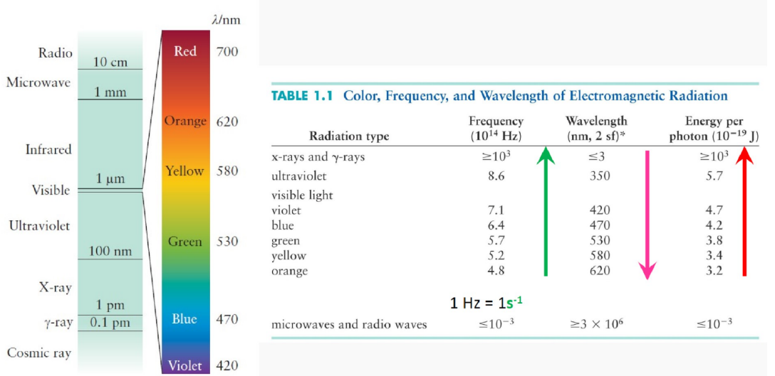
Radiation
ctpp!

Slide 13
Black Body
Wien’s Law:
There’s a maximal wavelength at which the intensity is the highest.
λmax × T = b (b=2.897 × 10^(−3)m · K)
Stefan Boltzmann Law:
The total indensity of radiation=constant ×T^4
constant=5.67 × 10^(−8)W · m^(−2) · K^(−4)
ctpp

Slide 14
Hydrogen Spectrum
Bohr’s Model:
Electrons orbit the nucleus in orbits which have set size & energy.
Energy of orbit relates to its size (like planet model).
When electrons move from one orbit to another, energy is emmited or absorbed in the form of radiation.

Slide 15
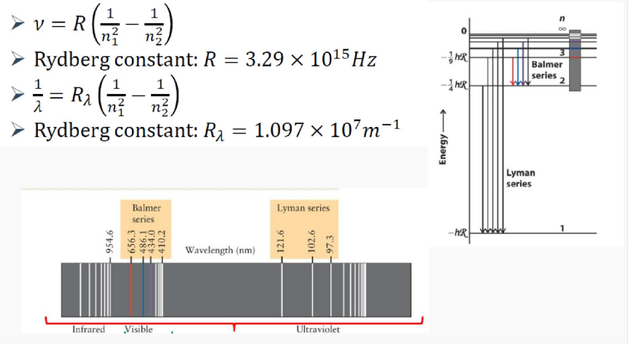
Formulas
copy it to ctpp!

Slide 16
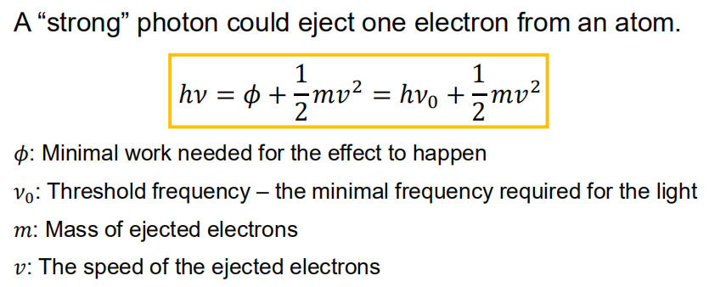
Photoelectric Effect

Slide 17
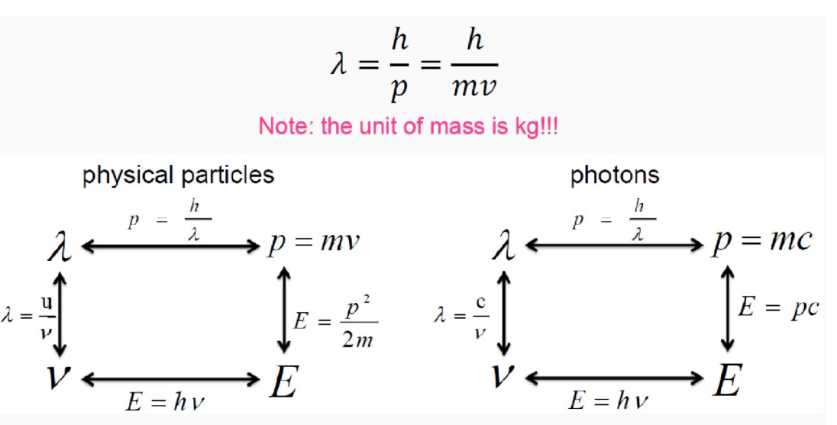
Wave-Particle Duality of Matter
Important!

Slide 18
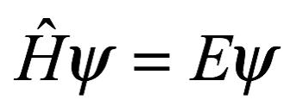
Schrödinger Equation
You may ask why we can’t cancel the sai on both sides of the equation, the answer is that the Hamiltonian is an operator rather than a variable, and the left side of the equation contains the second order derivative of the wave function sai.

Slide 19
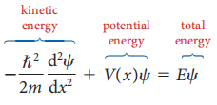
Schrödinger Equation
Schrödinger Equation without time t
This is an equation whose position in quantum mechanics is equivalent to that of Newton's second law in classical mechanics

Slide 20
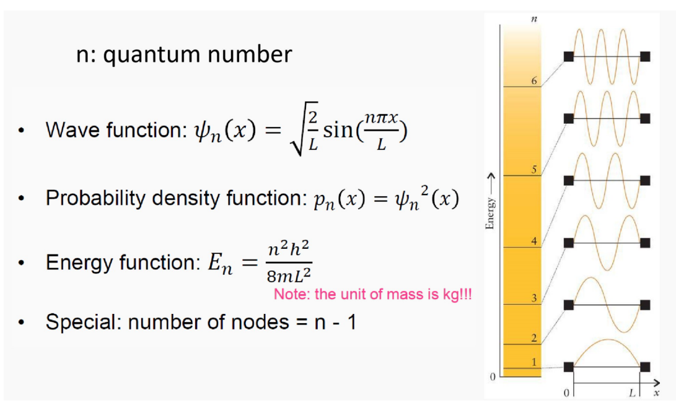
Some conclusion about the equation
1 D condition

Slide 21
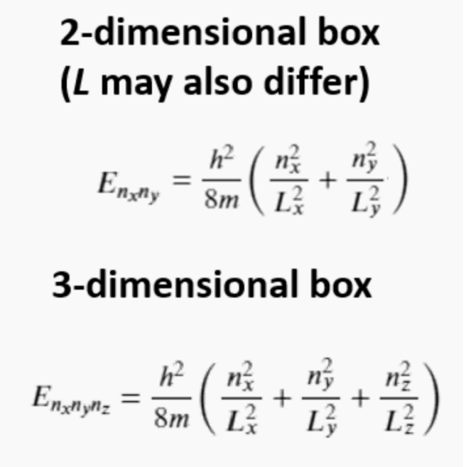
n-D box
You don’t need to know how to solve the equation because it will not be tested in the exam, copying these results to the ctpp is enough.But if you do want to know how to solve the equation, feel free to come to the OH and I will solve the equation in 1-D or 3-D case in front of you.

Slide 22
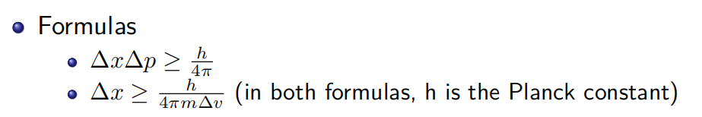
Heisenberg’s Uncertainty Principle

Slide 23
Reference
[1] CHEMICAL PRINCIPLES-THE QUEST FOR INSIGHT
(Seventh Edition)
[2] Inorganic Chemistry
[3] Wei Xiwen, RC1, VC210 FA2020
[4] Shi Weili, RC1, VC210 FA2020
[5] Huang qin, RC1,VC210 FA2020

Slide 24
Thank you~

